Slide 1
PROGRESS REPORT · ECSP6007
STOCK MARKET
ANALYSIS &
PREDICTION
Roll No. | Name of Student
B-20 | Rishikesh Chikhale
B-26 | Saie Amdhare
B-52 | Amogh Shukla
A-56 | Abhishek Malhotra
AI-Based Decision Support Platform for the Indian Stock Market
B.Tech Electronics and Computer Science · Semester VII · 2026–27
Shri Ramdeobaba College of Engineering and Management, Nagpur
Under the guidance of Dr. Jayu Kalambe

Slide 2
01 / REVIEW MAP
THE PLATFORM
CONTENTS
1
Introduction and motivation
2
Problem statement
3
Objectives and scope
27
4
Literature review and research gap
technical indicators feed the comparison of Gradient Boosting, ARIMA and LSTM models.
5
System architecture and dataset
6
Exploratory data analysis

Slide 3




02 / WHY THIS PROJECT
INTRODUCTION AND MOTIVATION
Market growth · tool gap · research opportunity
A fast-growing market
More retail investors need interpretable signals.
A visible tool gap
Free platforms (NSE, Moneycontrol, Groww, TradingView) provide raw data and charts, but no prediction or reasoning.
AI can scale pattern finding
275%
Machine learning finds patterns in large historical datasets faster and more consistently than a human analyst.
Rise in Indian retail-investor accounts: about 4 crore (2019) to over 15 crore (2024).
The academic opportunity
AI stock-prediction research rarely becomes practical, user-friendly systems. This project pairs model evaluation with an explainable end-to-end decision-support platform for the Indian market.

Slide 4
03 / THE PROBLEM
USEFUL MARKET DATA STILL LEAVES THE DECISION TO THE USER
# | Problem | What goes wrong
1 | Information overload | News, social media, earnings and analyst calls conflict; no single actionable signal.
2 | No predictive intelligence | Free tools show data and charts only, with no ML-based trend or recommendation.
3 | Black-box AI | Paid tools output BUY/SELL with no reasoning, so users cannot trust them.
4 | Manual technical analysis | RSI, MACD and Bollinger Bands by hand are slow, error-prone and difficult to scale.
5 | No model comparison | Investors rely on one method, with no easy way to compare approaches.

Slide 5
04 / RESEARCH DESIGN
BOUNDARIES
OBJECTIVES AND SCOPE
SCOPE
End-of-day NSE OHLCV; live refresh every 5 minutes during market hours, 9:15 AM–3:30 PM IST.
TVS Motor, Solar Industries and HDFC Bank.
Short-term positional trading, 1 to 30 days; not intraday.
Technical analysis only. News sentiment and fundamentals are future work.
Hosting on Streamlit Community Cloud.
Build broadly · evaluate honestly · explain every signal
1
Collect and clean 7+ years of NSE OHLCV data.
2
Compute 27 technical indicators and perform EDA.
3
Train Gradient Boosting, ARIMA and LSTM models.
4
Add BUY / HOLD / SELL with confidence and SHAP explanations.
5
Deploy an interactive Streamlit dashboard.

Slide 6
05 / PRIOR WORK
LITERATURE REVIEW
From ensemble accuracy to explainable finance
Author(s) | Year | Key finding | Relevance
Patel et al. | 2015 | Random Forest leads Indian NSE stocks (80%+). | Validates Indian ensembles.
Khaidem et al. | 2016 | RF + indicators: 80%+ accuracy (NYSE). | Validates features.
Selvin et al. | 2017 | LSTM superior on NSE data. | LSTM for India.
Lundberg and Lee | 2017 | SHAP: game-theory feature attribution. | Basis of XAI layer.
Fischer and Krauss | 2018 | LSTM beats ARIMA on S&P 500 direction. | Three-model comparison.
Bussmann et al. | 2020 | SHAP explanations build trust in AI finance. | Transparency-first design.

Slide 7
06 / THE GAP
RESEARCH GAP
What existing studies leave unresolved
Deployment: all reviewed studies stop at model training and evaluation; none delivers a deployable dashboard for a non-technical retail investor.
Comparison: most studies use a single model or stock, so cross-model and cross-sector comparison is not possible.
Trust: existing AI tools are black boxes, with no explanation of their signals.
MODELS ARE
NOT ENOUGH.
This project: Gradient Boosting, ARIMA and LSTM compared across three sectors on one live, explainable, deployable platform.
A usable platform must connect evidence, comparison and explanation.

Slide 8
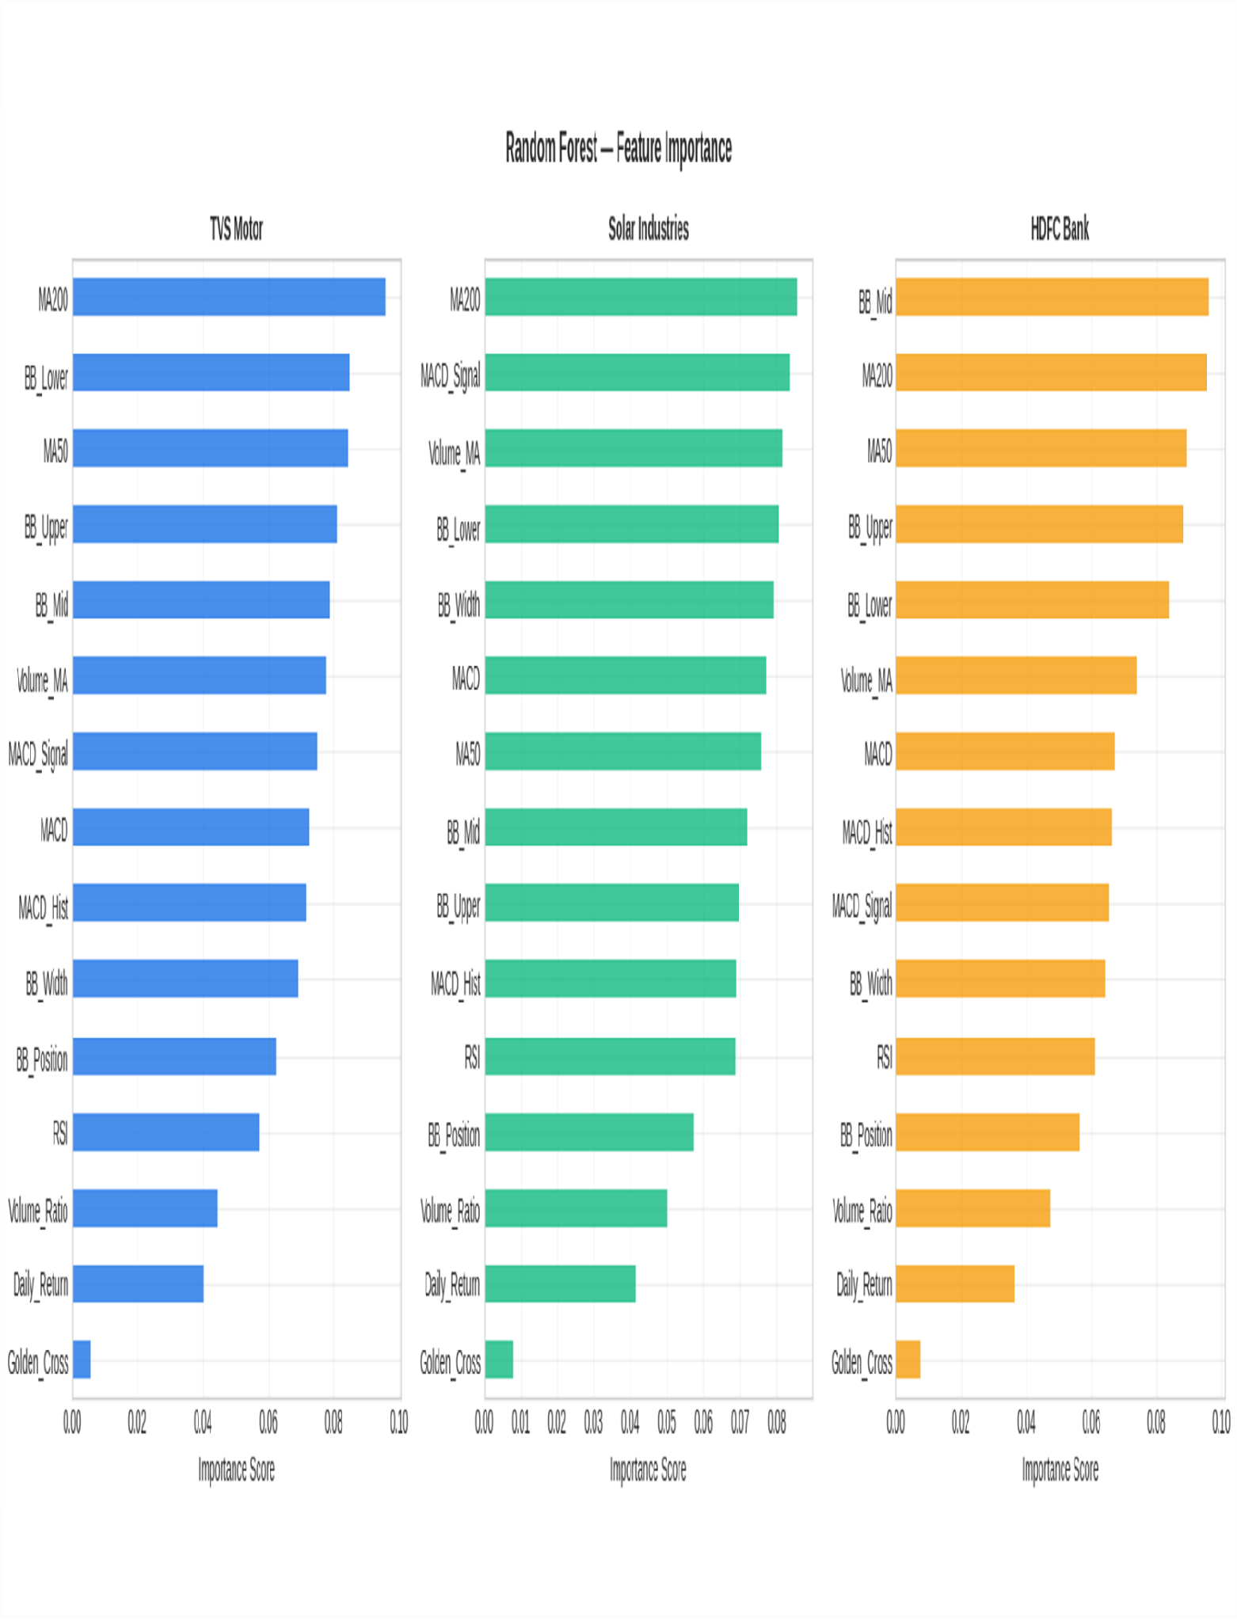
07 / SYSTEM DESIGN
SYSTEM ARCHITECTURE
Seven layers from market data to an explainable dashboard
1
L1 Data acquisition: yfinance; TVSMOTOR.NS, SOLARINDS.NS, HDFCBANK.NS.
2
L2–L3 Preparation: cleaning, 27 indicators and UP/DOWN labels.
3
L4 ML: Gradient Boosting, ARIMA(3,1,1), LSTM and Linear Regression.
4
L5 Evaluation: Accuracy, F1, AUC, RMSE, MAPE, AIC and backtest.
5
L6 Explainability: SHAP TreeExplainer.
6
L7 Presentation: Streamlit + Plotly dashboard.

Slide 9
08 / DATA FOUNDATION
DATASET DESCRIPTION
Yahoo Finance via yfinance · 2 Jan 2019 to 1 Oct 2026
Stock | NSE ticker | Sector | Rows | Avg close | Max close | Min close
TVS Motor | TVSMOTOR.NS | Auto and EV | 1,919 | Rs. 1,514.81 | Rs. 4,466.20 | Rs. 245.87
Solar Industries | SOLARINDS.NS | Defence | 1,918 | Rs. 6,000.66 | Rs. 22,455.00 | Rs. 837.29
HDFC Bank | HDFCBANK.NS | Banking | 1,919 | Rs. 713.61 | Rs. 996.42 | Rs. 357.66
5,756 rows
Seven-plus years
Master dataset with zero missing values; auto_adjust=True handles splits, bonus and dividends.
Includes the COVID crash, V-shaped recovery, 2021–22 bull run and 2023–24 correction.

Slide 10
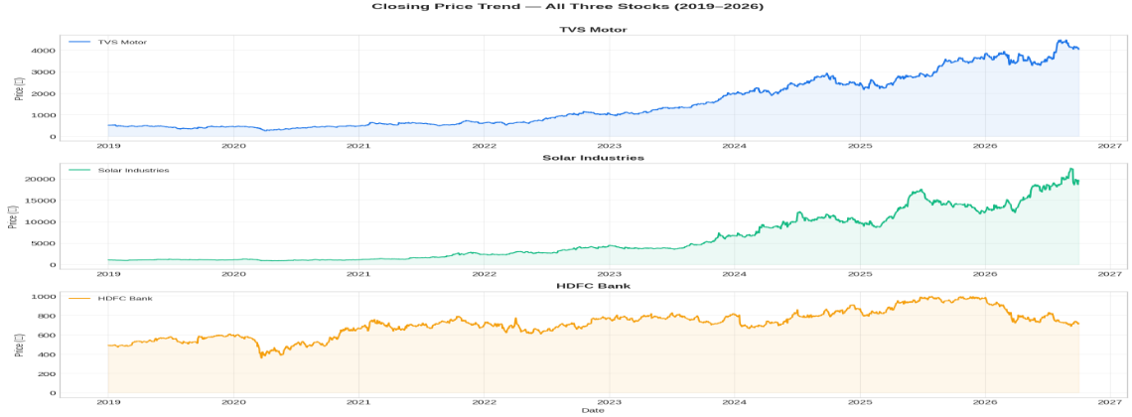
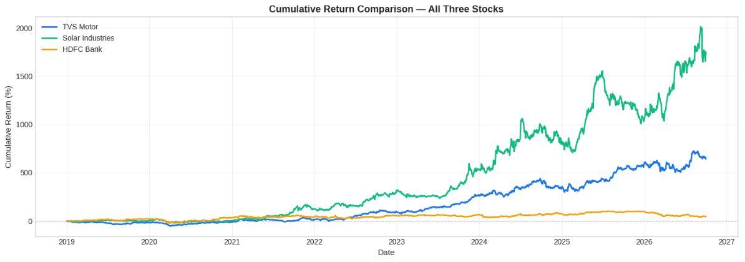
09 / EXPLORATORY DATA ANALYSIS
PRICE AND RETURNS REVEAL THREE DIFFERENT MARKET BEHAVIOURS
Closing price trend · cumulative return comparison · 2019–2026
Closing price trend, 2019–2026
Cumulative return comparison
~2,000% · Solar Industries
~650% · TVS Motor
~50% · HDFC Bank
Common shock
Steady compounding from two-wheeler demand and EV adoption.
Drawdown in 2023–24 after the HDFC merger.
March 2020 crash is the minimum price for all three stocks.
Flat until 2023, then a sharp rise (defence spending push).
EDA sets the modelling context: sector, volatility and market regime matter before any prediction is made.

Slide 11
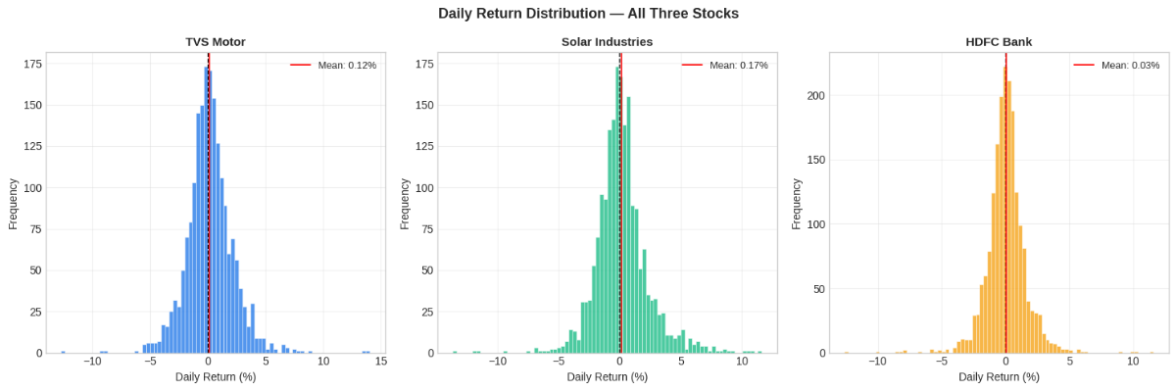
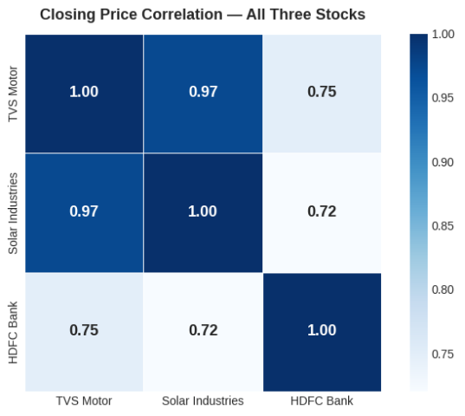
01 · EXPLORATORY DATA ANALYSIS
EXPLORATORY DATA ANALYSIS: VOLATILITY AND CORRELATION
Daily returns reveal risk; closing prices reveal co-movement.
Daily return distribution
Closing price correlation
Stock | Total return | Daily volatility | Max gain | Max loss
TVS Motor | ~650% | 2.005% | +14.04% | -12.76%
Solar Industries | ~2,000% | 2.128% | +11.62% | -11.77%
HDFC Bank | ~50% | 1.571% | +11.60% | -12.61%
HDFC Bank is the most stable; Solar Industries the most volatile. TVS and Solar closing prices correlate at 0.97; HDFC is 0.72 to 0.75.

Slide 12
Category | Features · purpose
Trend (5) | MA50, MA200, Golden Cross, Price_vs_MA50, Price_vs_MA200 — Long and short-term trend direction
Momentum (7) | RSI(14), RSI Overbought/Oversold, MACD, Signal, Histogram, MACD Positive — Speed and strength of price moves
Volatility (7) | Bollinger Upper/Mid/Lower, BB Width, BB Position, Volatility 5d and 10d — Volatility regime and price extremes
Volume (3) | Volume MA(20), Volume Ratio, Volume Spike (ratio > 1.5) — Conviction behind moves
Return (5) | Daily Return, Return 1d, 3d, 5d, 10d — Momentum across time horizons
02 · FEATURE ENGINEERING
27
Price and volume: Five source columns become the model input. Indicators: Trend, momentum, volatility, volume and return features. Signal: Features support UP/DOWN classification and forecast models.
technical indicators
RSI = 100 - 100/(1+RS); MACD = EMA(12) - EMA(26); Bollinger = 20-day SMA +/- 2 SD. The first 200 rows were dropped for MA200; RSI showed 15-20 in the March 2020 crash.
From raw OHLCV data to signals a model can learn.

Slide 13
03 · PRIMARY CLASSIFIER
TARGET AND SPLIT
MODEL 1: GRADIENT BOOSTING CLASSIFIER
Chronological, leakage-free
UP (1) if the close 5 days later is higher; otherwise DOWN (0).
Sequential ensemble learning turns feature corrections into a directional signal.
70% train · 15% validation · 15% test
Signal generation
Step | Ensemble learning
Start | Train the first tree on the engineered indicators.
Correct | Each tree corrects the errors of the previous one.
Combine | 300 trees create the final classifier.
UP probability | Signal
> 55% | BUY
45% to 55% | HOLD
< 45% | SELL
Binary labels are near-balanced: TVS Motor 44.5% DOWN / 55.5% UP; Solar Industries 47.1% / 52.9%; HDFC Bank 47.6% / 52.4%.
Learning rate 0.05; max_depth=5; subsample=0.8; class_weight="balanced"; random_state=42. Each tree adds 5% of its correction.

Slide 14
04 · FORECAST MODELS
MODELS 2, 3 AND 4: ARIMA, LSTM, LINEAR REGRESSION
Different horizons require different assumptions about price behaviour.
Model | Task / horizon | Settings and evidence
ARIMA(3,1,1) | 7-day forecast | Fitted on the last 200 days in the dashboard; AIC: 15,706 TVS; 21,584 Solar; 12,727 HDFC; reverts to mean beyond 7 days.
LSTM | Next-day price | 60-day closing-price sequences, MinMax scaled; 2 LSTM layers, 50 units; dropout 0.2; Dense 25, Dense 1; Adam lr 0.001, batch 32, early stopping patience 5; stopped at 10 / 11 / 50 epochs.
Linear Regression | 30-day trend | Fitted on the last 90 trading days; confidence band widens from 1 to 3.5 volatility units; added because ARIMA is too flat for 30 days.

Slide 15
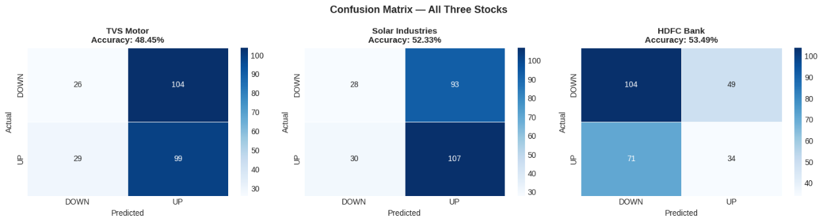
05 · CLASSIFICATION RESULTS
RESULTS: GRADIENT BOOSTING EVALUATION
Confusion matrices: TVS, Solar, HDFC
The classifier finds a modest signal, with recall behaving differently across sectors.
±5% Results vary between runs due to subsampling.
Stock | Accuracy | Precision (UP) | Recall (UP) | F1 | AUC
TVS Motor | 48.45% | 0.49 | 0.77 | 0.60 | 0.567
Solar Industries | 52.33% | 0.54 | 0.78 | 0.64 | 0.510
HDFC Bank | 53.49% | 0.41 | 0.32 | 0.36 | 0.519
Accuracy is 48-53% against a 50% random baseline; stock direction is hard to predict in an efficient market.
TVS and Solar models have a buying bias: high UP recall (about 77%) but low DOWN recall. HDFC Bank is the most balanced; it detects 68% of DOWN days, useful for risk management.
Patel et al. (80%+) used a calmer pre-2015 period; recent post-2020 studies report about 52-62%.

Slide 16
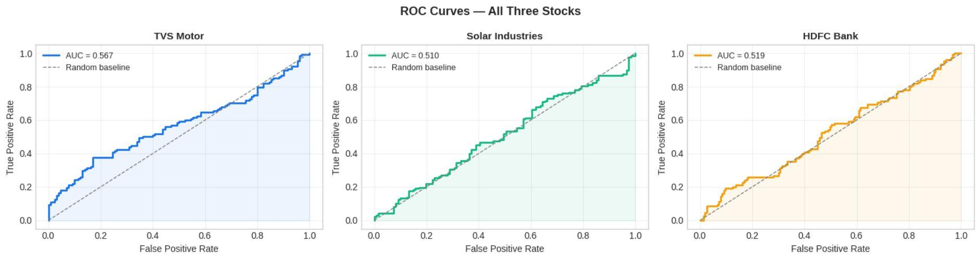
LSTM REGRESSION
06 · MODEL COMPARISON
Stock | AUC | LSTM RMSE | LSTM MAPE
TVS Motor | 0.567 | Rs. 129.14 | 2.57%
Solar Ind. | 0.510 | Rs. 734.37 | 3.43%
HDFC Bank | 0.519 | Rs. 14.43 | 1.33%
RESULTS: ROC CURVES, LSTM AND ARIMA
ROC curves with AUC scores
LSTM MAPE: below 5% on all three stocks; HDFC Bank lowest, 1.33%.
Solar RMSE looks large because price is above Rs. 6,000; MAPE comparable.
ARIMA 30-day ranges nearly flat; HDFC Rs. 990.10 to 990.52 confirms its short-horizon limit.
AUC > 0.5
A small but genuine learned signal; TVS is strongest.

Slide 17
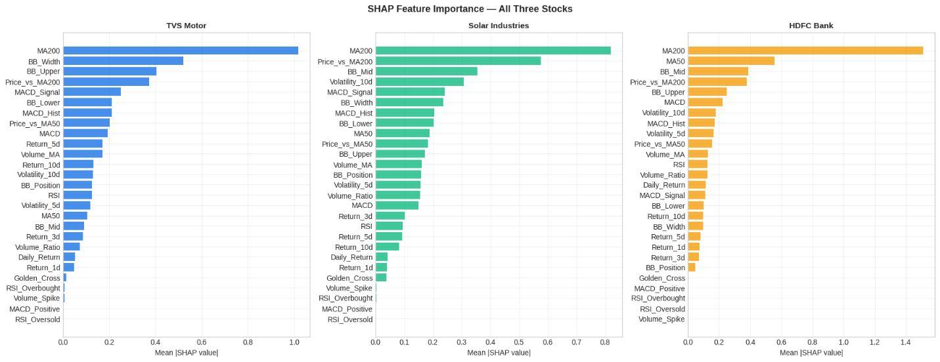
07 · EXPLAINABILITY
SHAP EXPLAINABILITY ANALYSIS
SHAP feature importance, mean |SHAP|
Rank | TVS Motor | Solar Ind. | HDFC Bank
1 | MA200 (1.014) | MA200 (0.786) | MA200 (1.498)
2 | BB_Width (0.539) | Price_vs_MA200 (0.557) | MA50 (0.521)
3 | BB_Upper (0.416) | BB_Mid (0.396) | BB_Mid (0.435)
Feature-level attribution turns a model output into a decision-support explanation for a retail investor.
MA200
Top feature across three sectors. The model independently rediscovered the classic 200-day moving average principle.
TVS BUY instance: bullish MA200 +0.884, Price_vs_MA200 +0.445, MACD_Hist +0.355; bearish BB_Width -0.662, BB_Upper -0.526, BB_Lower -0.478.

Slide 18
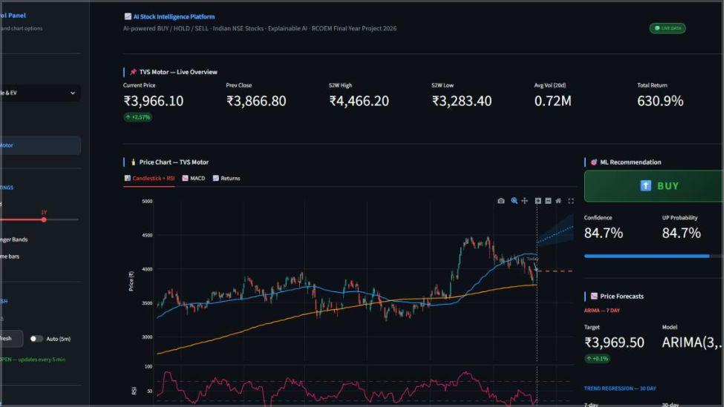
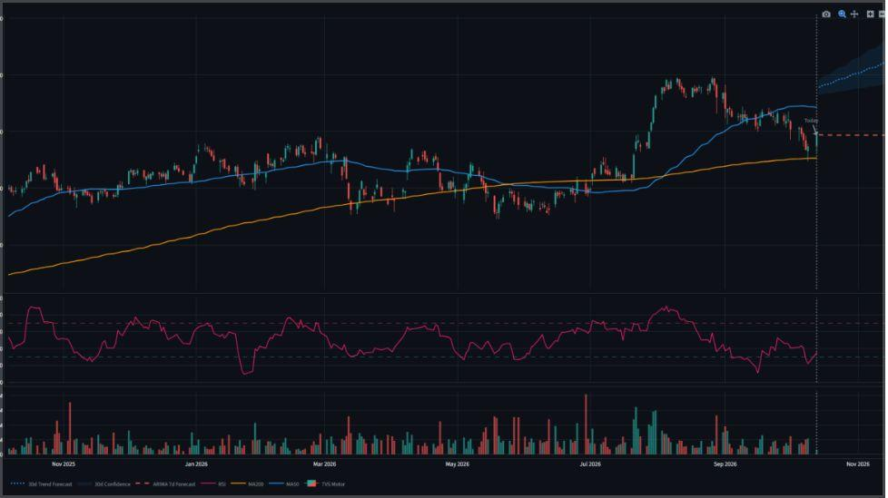



From model output to decision support
08 · PRODUCT DELIVERY
Main dashboard view
Candlestick with ARIMA and 30-day trend forecast
Explore
Measure
Act with context
DASHBOARD
DEVELOPMENT
Sector selector, time-period slider, Bollinger/volume toggles, manual and auto 5-minute refresh, market open/closed indicator.
Price, previous close, 52-week high/low, 20-day volume and total return.
ML recommendation with confidence, RSI gauge, technical scoreboard and SHAP “Why this recommendation?” panel.
Streamlit + Plotly
Model output becomes a usable investor workflow.

Slide 19
09 · PRACTICAL PERFORMANCE
BACKTESTING RESULTS
The held-out test set shows where the strategy protects capital and where it misses persistent trends.
Stock | Start capital | Final value | Model return | Buy and hold | Trades | Win rate
TVS Motor | Rs. 1,00,000 | Rs. 1,13,676 | +13.7% | +14.9% | 197 | 50.3%
Solar Industries | Rs. 1,00,000 | Rs. 1,03,686 | +3.7% | +34.2% | 190 | 50.5%
HDFC Bank | Rs. 1,00,000 | Rs. 91,601 | -8.4% | -23.4% | 71 | 40.8%
15 PTS
Strategy rule
Buy when UP probability > 55%; hold cash when < 45%.
TVS Motor nearly matched buy-and-hold, only 1.2 points lower. Solar Industries lagged because cash periods missed a persistent bull run. Overall, the model is better at limiting losses in falling markets than at beating strong uptrends.
capital preserved by HDFC Bank versus buy-and-hold

Slide 20
10 · TROUBLESHOOTING ARC
DIFFICULTIES ENCOUNTERED AND RESOLUTIONS
The pipeline became reliable by resolving problems phase by phase, from data preparation to model delivery.
Phase | Problem | Resolution
3 | Close column loaded as string from yfinance metadata rows | Custom loader with pd.to_numeric() and row filtering
3 | Date index loaded as plain strings | Explicit pd.to_datetime() conversion
6 | Accuracy 32-41% due to NaN rows from MA200 | Strict dropna() before training
6 | 3-class accuracy 35-52%; HOLD class dominated | Switched to binary UP/DOWN; HOLD from confidence band
7 | ARIMA: no supported index | asfreq("B") business-day frequency
8 | pandas 2.x removed .last() | Replaced with .tail()
8 | Empty data outside market hours | len(df) checks and clear error messages
8 | ARIMA 30-day forecast too flat | Added Linear Regression trend model
01
02
03
DATA
MODEL
DELIVERY
Clean and index
Prevent leakage
Make it usable
Types, dates, missing values.
Chronological split and balanced labels.
Clear errors, robust forecasts and a dashboard.

Slide 21
CLOSING REVIEW · PLATFORM ARC
WHAT THE PLATFORM DELIVERS
From market data to an accessible decision-support workflow.
Prepare
Compare
Present
Data preparation across historical Indian market data.
Model comparison across Gradient Boosting, ARIMA and LSTM.
Dashboard development turns outputs into a usable workflow.
Engineer
Explain
Backtest
Feature engineering turns prices into technical indicators.
SHAP makes the signals inspectable.
Backtesting connects model behaviour to decisions.
COMPLETED ARC · PREDICTION → INTERPRETATION → DECISION SUPPORT
Notes:
This closing section brings the completed research and implementation arc together: data preparation, feature engineering, model comparison, explainability, dashboard development and backtesting. The platform combines predictive models with an accessible decision-support workflow.

Slide 22
CONCLUSION
WHAT IS COMPLETE
Phases 2 to 8 are complete; Phase 9, Streamlit Cloud deployment, is in progress.
The platform combines
FROM MODELS
TO DECISIONS
Predictive models and model comparison
SHAP explanations for interpretable signals
A dashboard designed for practical usability
Backtesting to examine decision behaviour
A deployable, explainable dashboard direction for Indian retail-market analysis.
PERFORMANCE IS EVIDENCE · USABILITY IS THE DELIVERY TEST
Notes:
The conclusion is deliberately two-part. Model performance matters, but it is not the same as practical usability. The project direction is a deployable, explainable dashboard, without overstating investment certainty. Phases 2 to 8 are complete, while Phase 9, Streamlit Cloud deployment, remains in progress.

Slide 23
INTERPRETATION BOUNDARIES
LIMITATIONS THAT SHAPE INTERPRETATION
The results are useful within a defined historical and technical boundary.
1
2
3
No tick-by-tick data
No news or sentiment
No transaction-cost modelling
The platform uses end-of-day market data, not tick-by-tick streaming; paid APIs would be needed for that layer.
News sentiment and fundamental data are outside the current technical-analysis scope.
Backtesting does not model transaction costs; returns should not be read as realised investment outcomes.
4
5
6
Limited stock coverage
Limited historical scope
Deployment still in progress
The current platform covers three stocks; findings do not represent the full Indian market.
The evidence comes from a limited historical window and cannot establish performance across every market regime.
There is no live deployment yet. The LSTM model is not saved; the dashboard currently uses a linear estimate.
Notes:
These limitations do not invalidate the work. They define how the work should be read: as an explainable research and decision-support platform, evaluated on a limited historical, technical-analysis dataset, not as a guarantee of live investment performance.

Slide 24
NEXT BUILD CYCLE
FUTURE SCOPE: THE NEXT BUILD CYCLE
A practical sequence from current prototype to broader decision support.
01
02
03
04
Deploy
Enrich
Broaden
Improve
Finish cloud deployment and move the dashboard toward live access.
Add richer sentiment or news signals, including FinBERT news sentiment.
Expand stock coverage beyond the current three-stock scope.
Continue improving the modelling and dashboard, including LSTM inference and P/E and earnings data.
PHASE 9 IN PROGRESS · THE NEXT BUILD EXTENDS THE SAME EXPLAINABILITY PRINCIPLE
Notes:
The next cycle is practical rather than speculative: finish cloud deployment, enrich the signal set with news sentiment and fundamentals, expand stock coverage, and continue improving both the modelling and the dashboard. Deploying LSTM inference is part of that progression.

Slide 25
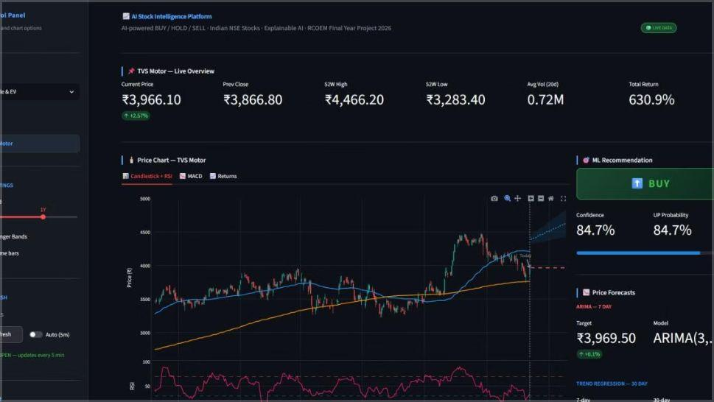
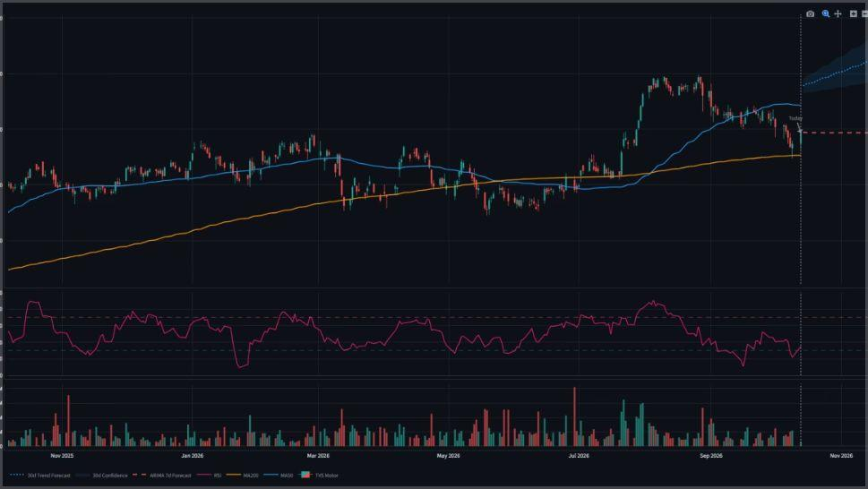
OUTPUT SCREENSHOTS
OUTPUT SCREENSHOTS AND FINAL TAKEAWAY
Main dashboard view
Candlestick with ARIMA and 30-day trend forecast
OUTPUT EVIDENCE · DASHBOARD + FORECAST VIEW
The output area is shown through the dashboard views produced for the project. The screenshots remain evidence of the interface, not a substitute for the underlying analysis.
EXPLAINABLE AI-BASED SUPPORT PLATFORM
For Indian retail-market analysis.
Notes:
Close on the actual output area without inventing screenshots that were not present in the source. The core takeaway is an explainable AI-based support platform for Indian retail-market analysis: predictive models are connected to explanations, a dashboard workflow and backtesting, while the stated limitations remain visible.

Slide 26

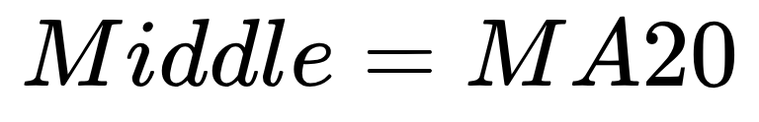
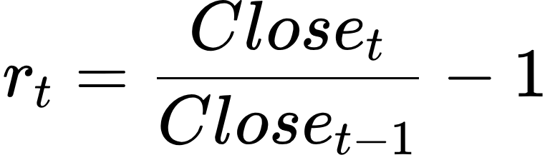
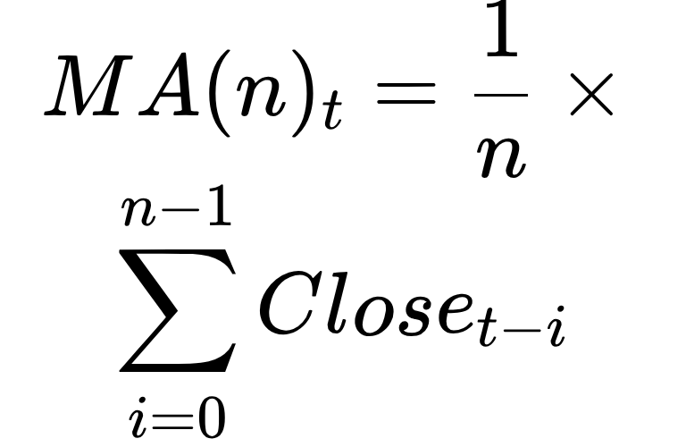
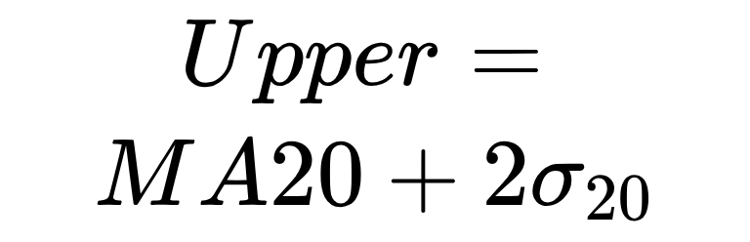
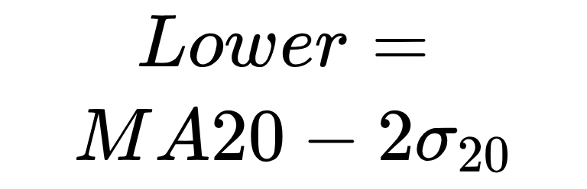
TECHNICAL APPENDIX · FEATURE ENGINEERING
TECHNICAL INDICATORS: THE FORMULAS BEHIND THE SIGNALS
TREND
VOLATILITY
RETURN
Simple moving average
Bollinger Bands
Daily return
rt compares today’s close with the prior close. Rolling return statistics support performance and risk comparisons.
Close is the closing price; n is the lookback window. MA50 and MA200 smooth medium- and long-horizon movement.
\sigma is the standard deviation of price over the window. The bands expand and contract with volatility.
Notes:
These are the first transformations in the feature-engineering pipeline. Moving averages describe trend, Bollinger Bands describe the changing volatility regime, and daily return converts price history into a comparable change series.

Slide 27



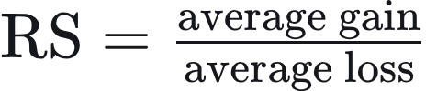

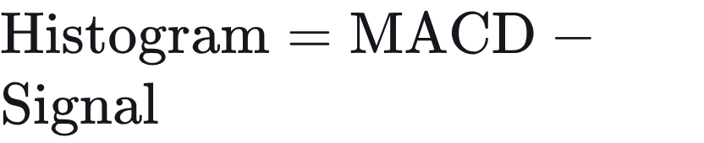
TECHNICAL APPENDIX · MODEL INPUTS
MOMENTUM, VOLATILITY
AND MODEL INPUTS
01
MOMENTUM
02
MOMENTUM
03
DISPERSION
RSI
MACD
VOLATILITY
Volatility is the standard deviation of the last n returns. Together with volume and return features, these indicators feed the comparison models.
RS is the average gain / average loss over the chosen window.
EMA is an exponential moving average.
Notes:
RSI and MACD describe momentum from different constructions. Volatility measures the dispersion of recent returns. Alongside volume and return features, these inputs give the comparison models several views of the same price history.

Slide 28
TECHNICAL APPENDIX · ENGINEERING REVIEW
CHALLENGES FACED
ACROSS THE PROJECT
Each difficulty required a concrete control in the data, modeling or delivery layer.
Phase | Problem | Practical response
DATA | Inconsistent data types, date indexes, missing values and empty datasets interrupted analysis. | Convert types explicitly, normalize the datetime index, apply missing-value handling, and check dataset length before analysis.
FEATURES | Rolling indicators create early missing rows, while future information can leak into the present. | Drop invalid rows after feature creation and preserve chronological train/test splits to prevent look-ahead leakage.
LABELS | Class imbalance made modest multi-class accuracy difficult to interpret without overstating the result. | Use the binary UP/DOWN framing for training and treat HOLD as a confidence-band recommendation.
Notes:
These challenges were coupled. Data quality affected indicators, leakage controls affected evaluation, class balance affected interpretation, and model-specific behavior affected the dashboard. The practical responses kept the pipeline usable without claiming more certainty than the results support.

Slide 29
TECHNICAL APPENDIX · ENGINEERING REVIEW
CHALLENGES FACED
(CONTINUED)
Model and delivery difficulties needed controls that keep forecasts and dashboard outputs readable.
Phase | Problem | Practical response
MODELS | ARIMA produced index warnings and short-horizon forecasts that were too flat. | Use a supported business-day frequency, constrain the short forecast horizon, and add a linear trend model for the longer view.
DELIVERY | Connecting trained models to a usable Streamlit + Plotly dashboard risked making metrics and recommendations hard to read. | Keep the dashboard layers explicit: model output, evaluation metrics and recommendations remain visible and understandable.
Notes:
The remaining challenges were the model-specific behavior and the dashboard delivery layer. Both were handled with explicit controls so the outputs stayed interpretable.

Slide 30
TECHNICAL APPENDIX · NEXT STEPS
1
Stronger models
FUTURE OUTLOOK
Benchmark ensemble and deep-learning forecasts against the current ARIMA and linear baselines.
Turning the analysis prototype into a dependable research tool for stock analysis.
2
Live data pipeline
Automate daily market data ingestion, validation and retraining so signals stay current.
3
Evaluation and trust
Add backtesting with transaction costs, drift monitoring and clear confidence ranges on every signal.
4
User-ready dashboard
Extend the Streamlit + Plotly dashboard with alerts, portfolio views and exportable reports.
Notes:
Next steps focus on stronger models, a live data pipeline, rigorous evaluation and a more complete dashboard for users.

Slide 31
TECHNICAL APPENDIX · CLOSING
THANK YOU
Questions and discussion welcome.
Notes:
Thank the audience and open the floor for questions about the models, the data pipeline and the dashboard.

